Slide 1
Void pointer
Presented by
S.Manikanta.

Slide 2
CONTENTS
Introduction to Void pointer
Void pointer as a single pointer
Void pointer as a double pointer
Function invocation using void pointer
Call back function using void pointer
Applications and Limitations
References

Slide 3
Introduction
The void pointer in C is a pointer that is not associated with any data type.
Irrespective of data type we can access the data from the appropriate storage location by using void pointer.so, it is known as generic pointer.
The name void itself indicates that the pointer doesn’t know about data type.
Compiler doesn’t understand how many bytes of data to be accessed from the assigned storage location , when it is dereferenced.
User as to type cast while dereferencing the void pointer.
Compiler decide The size of void pointer is same as general pointer.
Declaration:
void *<pointer name>
Example: void *ptr;
For general pointer the address that is assigned to any pointer must have the same data type.

Slide 4
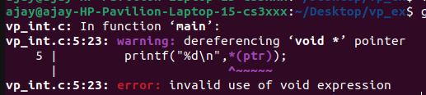
Why void pointer needs typecasting?
Compiler doesn’t understand how many bytes of data to be accessed from the assigned storage location , when it is dereferenced.
As it was generic pointer we need to do explicit typecast to intimate the compiler to access specific no of bytes from the assigned base address.
If we dereferenced the void pointer without typecast, the compiler will generate compilation Error.
Typecasting: *((<datatype>*)<pointer variable>)
Ex:
void main()
{
int x = 13; output:
void *ptr = &x;
printf(“%d”,*ptr);
}

Slide 5
Void pointer as a single pointer
Void pointer can be used as:
1.Integer pointer.
2.Character pointer.
3.Float pointer.
4.Double data type pointer.
5.Structure pointer.
Which can store variable base address, array base address, address returned by DMA calls.

Slide 6
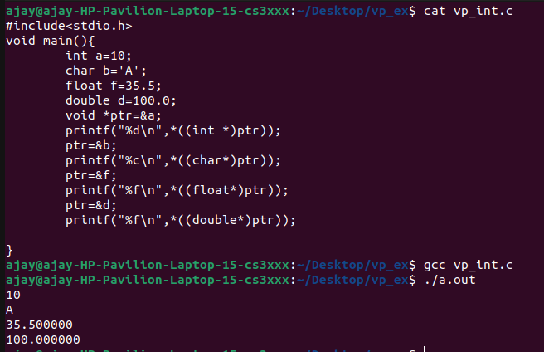
Example for Single void pointer: #include<stdio.h> void main() { int a=10; char b='A’; float f=35.5; double d=100.0; void *ptr=&a; printf("%d\n",*((int *)ptr)); ptr=&b; printf("%c\n",*((char*)ptr)); ptr=&f; printf("%f\n",*((float*)ptr)); ptr=&d; printf("%f\n",*((double*)ptr)); } output:

Slide 7
Void pointer as a Double pointer
Void pointer can be used as a double pointer, of any datatype
Which can store pointer variable address ,base address of an array of pointers and address returned by the by the dma calls for pointers.
Void pointer can be used as:
1.Integer double pointer.
2.Character double pointer.
3.Float double pointer.
4.Double data type double pointer.
5.Structure double pointer.

Slide 8
Example for double void pointer
#include<stdio.h>
void main(){
int a=10;
int *ip=&a;
char b='A';
char *cp=&b; output:
float f=35.5;
float *fp=&f;
double d=5.5;
double *dp=&d;
void *ptr=&ip;
printf("%d\n",**((int **)ptr));
ptr=&cp;
printf("%c\n",**((char**)ptr));
ptr=&fp;
printf("%f\n",**((float**)ptr));
ptr=&dp;
printf("%lf\n",**((double**)ptr));
}

Slide 9
Void pointer as a Function pointer
The function can be invoked by using the void pointer by assigning the address of the function.
The void pointer can be type casted as similar to the function declaration.
The single void pointer can be used to invoke the multiple functions.
Steps to invoke a function using void pointer:
Declare a void pointer.
Assign the address of function base address to the void pointer.
Type cast the pointer to function while invoking.

Slide 10
Example for void Function pointer:
#include<stdio.h> int add(int n,int m); void main() { int n=9,m=10; void *ptr; ptr=add; ((int(*)(int,int))ptr)(n,m); } int add(int n,int m){ printf("%d+%d=%d",n,m,n+m); return 0; }
Output:
9+10=19

Slide 11
Call back function using void pointer
Call back function means the function as the base address of another function as formal argument by using that address we can invoke that function.
To store the another function base address we can use void pointer. while invoking the another function again we have to typecast the pointer to that function declaration type.
Example:
#include<stdio.h> void print_int(int ,void *); void main() { output: int n=9; 9 print_int(n,printf); } void print_int(int n,void *p) { ((int (*) (const char*,...))p)("%d",n); }

Slide 12
Applications:
Dynamic memory allocation calls like malloc() and calloc() return void* type and this allows these functions to be used to allocate memory of any data type.
Declaration of malloc:
void *malloc(size_t size);
We can use array of void pointers to store and Access data or functions base address.
Declaration:
void* arr[size];
Limitations:
We cannot dereference void pointers directly to access the values stored at those addresses.
Pointer arithmetic on void pointers is not possible directly. Pointer need to be type cast into an appropriate data type.

Slide 13
References
C in Depth
From GeeksforGeeks website

Slide 14
Thank you…

